Slide 1
Open Innovation, or Business Model case of “OOOOOOO”
<Guide template for Open Innovation, or business model case presentation>
Firm: OOOO
Name: OOOO
Email: OOOO
Mobile Phone: OOOO
All contents of this guide for open innovation or business mode case presentation at SOItmC and CSCOM 2016 conference is from
“JinHyo Joseph Yun (2016): [Business Model Compass: from open innovation funnel to business model developing circle].
Springer Press(2016. August will be published)”.

Slide 2
Contents
Introduction(2-3 page)
Open Innovation Funnel(1-2page)
Technology and Market(2-3 page)
Customer OI BM Developing Circle
(Five factors * 2 or 3 page = 10-15 page)

Slide 3
1-1. Introduction
Firm
- product
- history, size, employee
- location and structure
- vision
- Intellectual Property
- homepage

Slide 4
1-2. Introduction
Characteristics of Innovation
Characteristics of Business Model

Slide 5
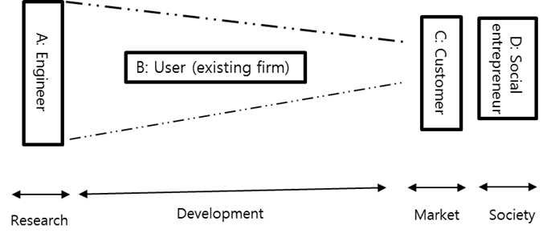
2. Open Innovation Funnel

Slide 6
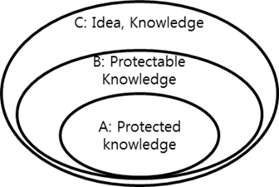
3-1. Technology and Market Three aspects of technology

Slide 7
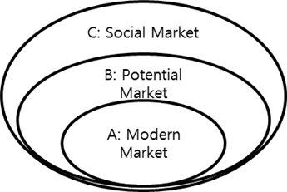
3.2. Technology and Market Three aspects of market

Slide 8
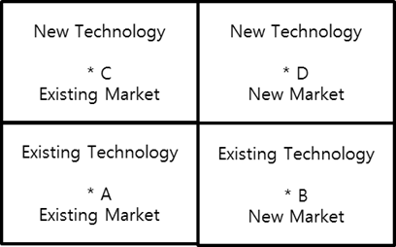
3.3. Technology and Market Quadrants of technology and market

Slide 9
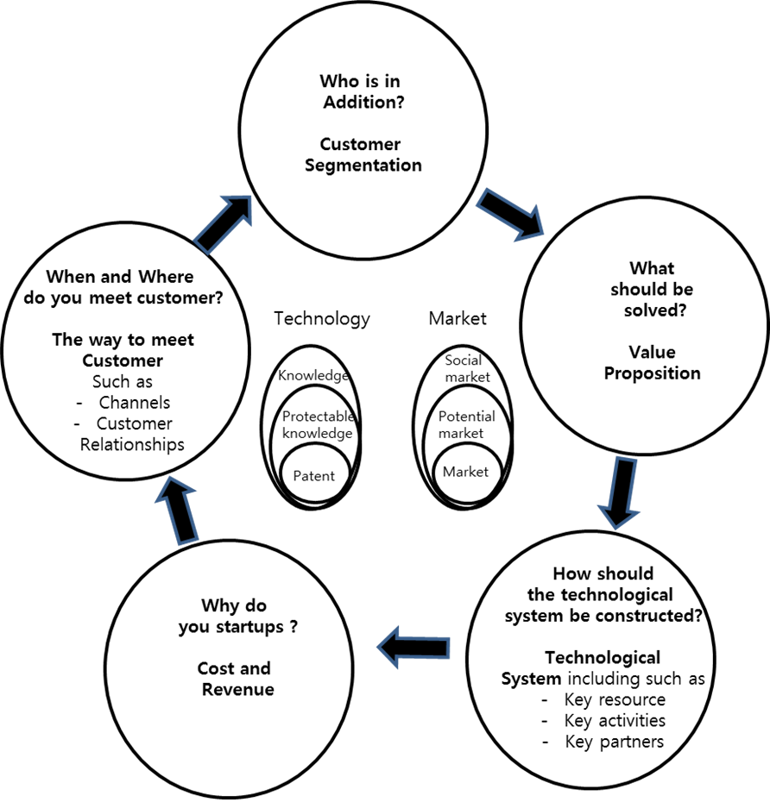
4-1. Customer BM Developing circle

Slide 10
4-2. Customer BM Developing circle
Customer Segmentation
(1) Describe your role as the person experiencing the problem.
(2) Describe objective customers who are experiencing this problem.
(3)Describe a concrete customer group through a measurable and recognizable form, for example, by showing practical cases or creating personas.

Slide 11
4.3. Customer BM Developing circle
2) Value Proposition
(1) Describe your own problem that should be solved, and arrive at a concrete value proposition.
(2) Describe your own requirement that should be realized, and arrive at a concrete value proposition
(3) Summarize the entire improvement by describing and giving shape to the concrete improvement in all aspects (quantitative, qualitative, functional, design, brand recognition, cost, cost reduction, and risk reduction improvement), and the improvement of the access to the value of the value proposition.

Slide 12
4.4. Customer BM Developing circle
Technological System
1)Compose a technological system, including key resources, key activities, and key partnerships, while taking into consideration the creative combination between technology and the market.
2) Form a technological system—that is, a creative combination between concrete and direct technology and the market—that cannot be easily copied, at least through patent application or design registration steps.
3) Compose a technological system in which a customer BM promotes connections between all members connected through the system, including the developer, and where the passionate participation of a customer BM developer and customers accelerate, inspiring significant change rather than gradual change.

Slide 13
4.5. Customer BM Developing circle
Cost and Revenue
1)A startup based on a customer BM cannot create profits for a long time; in addition, it takes a long time before the breakeven period arrives. To avoid this, it is important to design costs and revenues creatively.
2)Select a revenue form and price mechanism that rapidly generate revenue as soon as possible when selecting one from among various forms, such as product sales, usage fees, membership fees, rental fees, licensing, commissions, and advertisements, and/or when selecting the price mechanism, such as fixed pricing and dynamic pricing, during the design of a revenue stream.
3)Design a structure which prioritizes the fact that costs are needed for a long time when a cost structure is designed.

Slide 14
4.6. Customer BM Developing circle
Channels and Customer Relations
1) Creatively maintain the process, starting with the inner view of a customer BM developer and obtaining a nearby potential customer. To do this, when organizing the channel of an off-line or online store or a mobile Web store, minimize the initial cost of the customer BM and develop a concrete and direct method of meeting customers from experience, and then creatively apply the method.
2) In addition, the most proper method to share a critical mind between customers from a perspective of a customer is applied by a developer, and it is important to seek a means to allow customers to maintain their activities continuously. Find and apply the most valid and creative method, starting with the critical mind of a BM developer among various customer relations, such as the community, individual support, in-depth support, and customer co-creation processes.
3) During the customer BM development stage, concretely and directly design a method of expanding various customers to Grow Customers in advance; concretely and directly suggest this in the type of vision to be deployed in the near future, and form the momentum to maintain and continuously expand customers.

